Slide 1
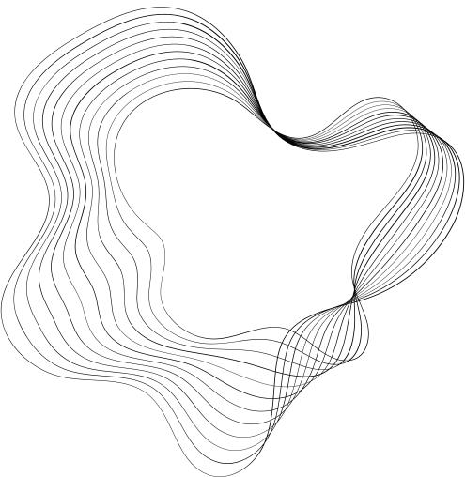

(GANS)
GENERATIVE ADVERSARIAL NETWORKS
BY GUEBLI AYOUB ABDESSAMI

Slide 2
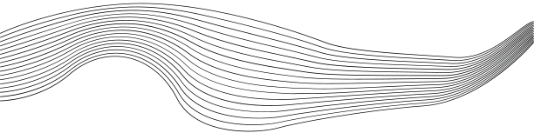
CONTENT
01
INTRODUCTION
02
GAN BASICS
03
GAN Architecture
04
HOW GANS WORK
05
APPLICATIONS OF GANS
06
Variants of GANs
07
CONCLUSION

Slide 3
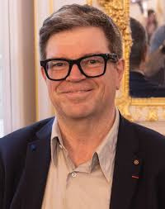


INTRODUCTION
Generative Adversarial Networks is the most interesting idea in the last ten years in machine learning.
“Yann LeCun, Director, Facebook AI"

Slide 4
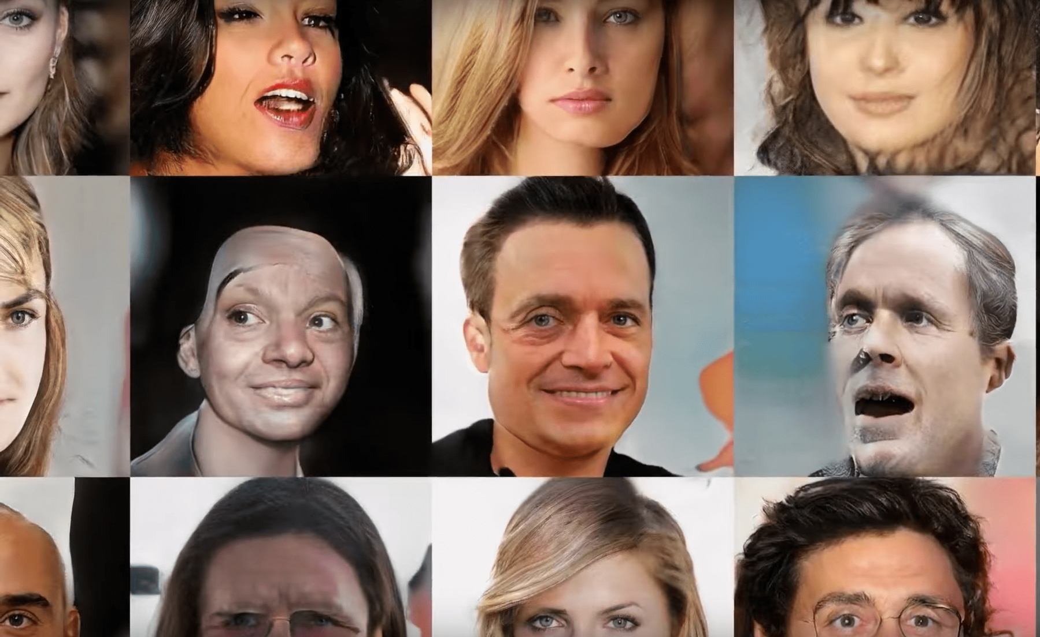


INTRODUCTION
Definition:
Generative deep learning models.
Generate synthetic data similar to input data.
Objective:
Produce data that appears "real" (examples: images, music, text).

Slide 5

QUESTION
So how can machines create data indistinguishable from real-world examples?

Slide 6
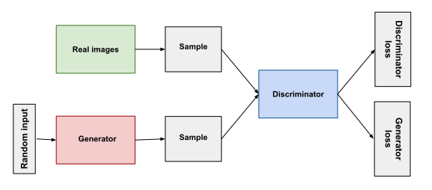



GAN BASICS
A GAN is composed of two main components:
Generator
Discriminator
This neural network generates synthetic data from random noise. Its goal is to produce outputs that are indistinguishable from real data.
This neural network evaluates data and determines whether it is real (from the training set) or fake (produced by the generator). It provides feedback to the generator to improve its outputs

Slide 7

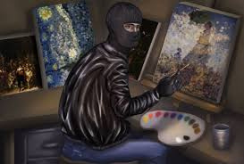

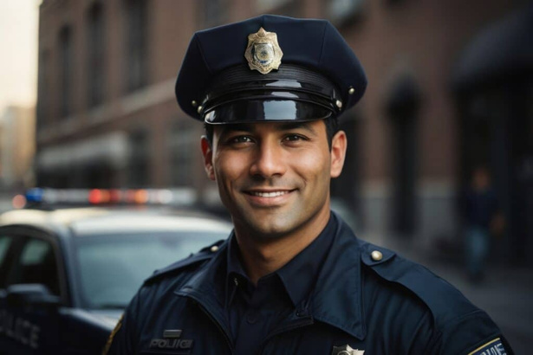
ANALOGY
AN ANALOGY OFTEN USED TO DESCRIBE GANS IS THAT OF A FORGER AND A POLICE OFFICER:
forger
The generator acts as a "forger" trying to create counterfeit currency (synthetic data) that looks as realistic as possible
police officer
The discriminator acts as a "police officer" attempting to detect the counterfeit currency (fake data) and differentiate it from genuine currency (real data).

Slide 8
GAN ARCHITECTURE

Slide 9

GENERATOR
01
02
03
INPUT
PROCESS
OUTPUT
Receives a random noise vector, often sampled from a Gaussian distribution.
Transforms this noise into a structured data output through a series of layers, including dense (fully connected) layers, batch normalization, and transposed convolutions.
Produces synthetic data, such as an image

Slide 10
DISCRIMINATOR
04
05
06
INPUT
PROCESS
OUTPUT
Takes in data samples, either real (from the dataset) or fake (from the generator).
Processes the input through layers that may include convolutions and activations to extract features.
Outputs a probability indicating whether the input is real or fake.

Slide 11
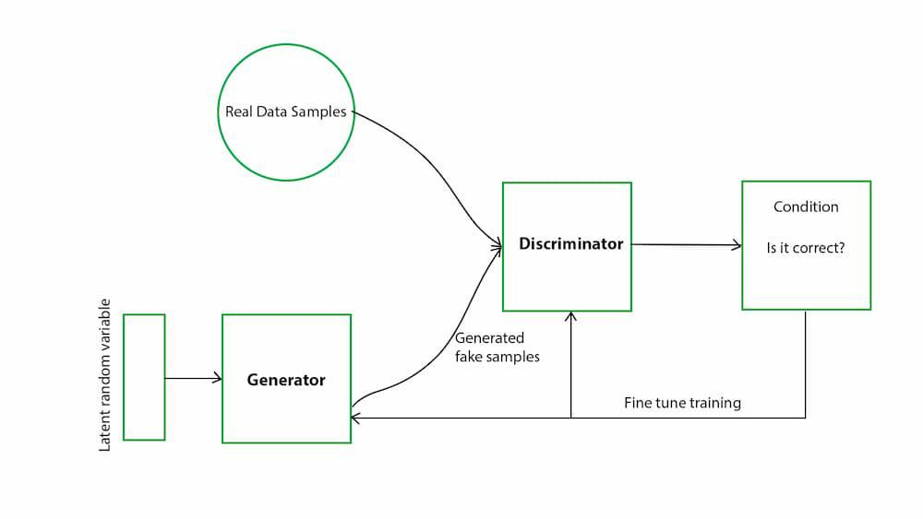

Slide 12

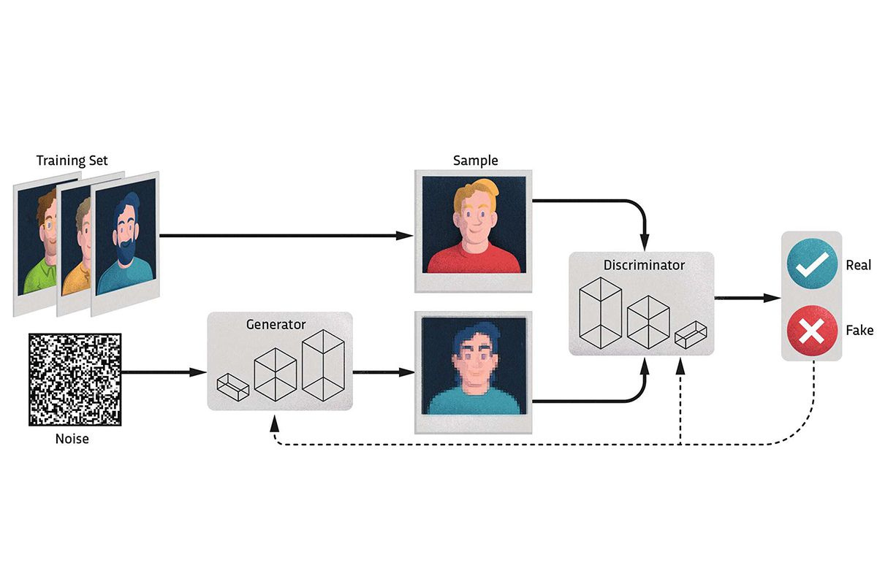
HOW GANS WORK
The training process of GANs involves the following iterative steps:
Generator Training: The generator creates synthetic data from random noise.
Discriminator Training: The discriminator evaluates a mix of real and synthetic data, learning to distinguish between the two.
Feedback Loop: The discriminator provides feedback to the generator, indicating how realistic the synthetic data is.
Iteration: This process repeats, with both networks continually improving—the generator in producing realistic data, and the discriminator in detecting fakes.
Over time, the generator becomes proficient at creating data that closely mimics real-world data, effectively "fooling" the discriminator.

Slide 13
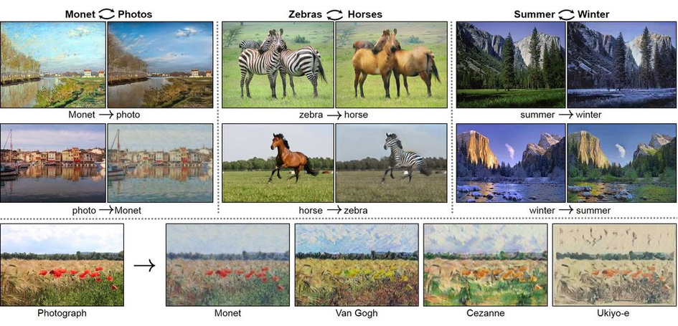
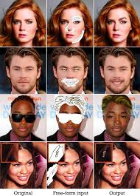
APPLICATIONS OF GANS
Image-to-Image
Image-to-Image Translation:
Transforming images from one domain to another, such as converting sketches to colored images or changing daytime scenes to nighttime
Photo Editing
Photo Editing:
Altering facial attributes like age, expression, or hairstyle in photographs.

Slide 14
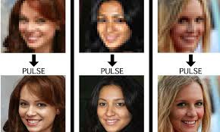
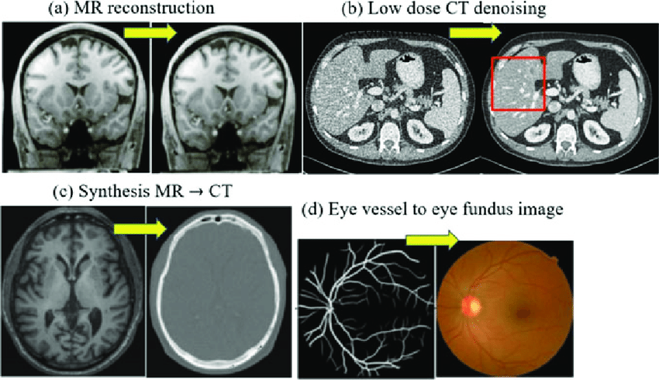
APPLICATIONS OF GANS
Super-Resolution:
Super-Resolution:
Enhancing the resolution of images, making them clearer and more detailed.
Medical Imaging
Medical Imaging:
Improving and generating medical images for better diagnosis and research

Slide 15
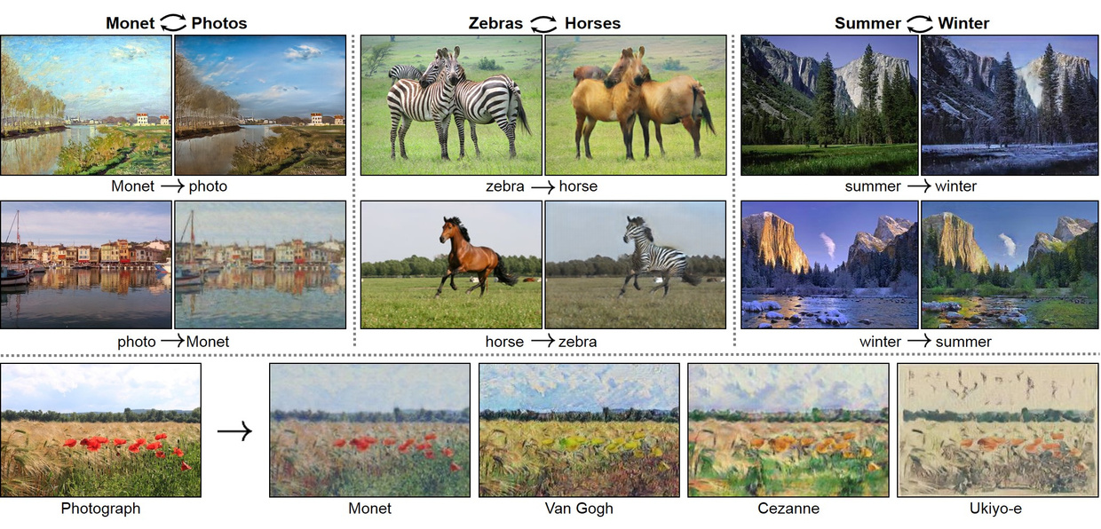
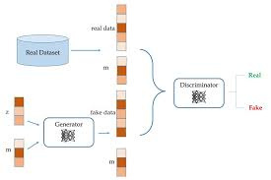
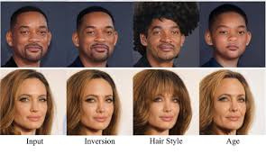
VARIANTS OF GANS
Several variants of GANs have been developed to address specific challenges and applications:
CYCLEGAN
CONDITIONAL GAN (CGAN)
STYLEGAN
Enables image-to-image translation without the need for paired datasets, useful in tasks like style transfer between different domains.
Focuses on high-resolution image synthesis, capable of generating photorealistic images with controllable styles.
Generates data based on conditional inputs, allowing for more controlled outputs, such as generating images of a specific class.

Slide 16
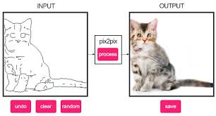
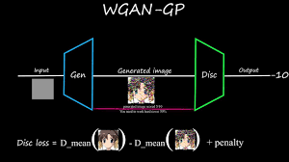
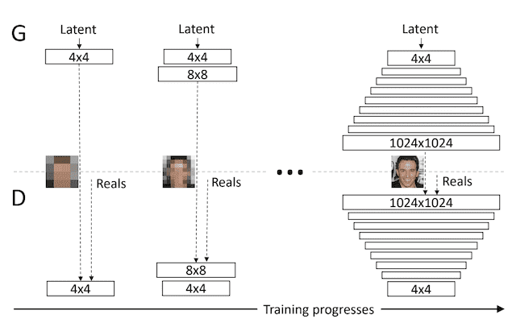
OTHER VARIANTS
WGAN (Wasserstein GAN ) : High-quality image generation and overcoming issues like mode collapse.
Pix2Pix GAN : Turning sketches into photorealistic images or colorizing black-and-white photos.
Progressive Growing GAN: High-quality image synthesis, including faces and complex scenes.

Slide 17
CONCLUSION
Generative Adversarial Networks (GANs) are a revolutionary tool in synthetic data generation, combining adversarial training to create highly realistic outputs. Despite challenges like computational demands, their versatility and potential for innovation make them indispensable in fields like image Generative Adversarial Networks (GANs) are a revolutionary tool in synthetic data generation, combining adversarial training to create highly realistic outputs. Despite challenges like computational demands, their versatility and potential for innovation make them indispensable in fields like image synthesis, medical imaging, and beyond. The future of GANs promises even more transformative applications., medical imaging, and beyond. The future of GANs promises even more transformative applications.

Slide 18

THANK'S FOR WATCHING
By Guebli Ayoub Abdessami

